Slide 1
TNSDC-Generative AI
Scrawl Digit classification using Deep learning
Presented by : Preetham.G,
au211521104116,
Pre-Final Student,
Computer Science and Engineering,
Panimalar Institute of Technology.

Slide 2

OUTLINE
Problem Statement
Proposed Solution
System Approach
Algorithm
Result
Conclusion
References

Slide 3
PROBLEM STATEMENT
The goal is to create a reliable system for handwritten digit recognition that can recognize numbers 0 through 9 from handwritten photographs. Convolutional neural networks (CNNs) are used for this. The system should be able to handle a range of handwriting styles and noise levels and deliver consistent recognition results across several datasets. Achieving great accuracy while preserving processing time efficiency is the aim.
The paraphrasing tool provided by QuillBot can assist you in rapidly and effectively reworking and rephrasing your sentences!

Slide 4
PROPOSED SOLUTION
Add what you We will create a web-based handwritten digit recognition system using Convolutional Neural Network (CNN) architecture in PyTorch. To extract pertinent features from handwritten digit images, the system will be composed of various layers of pooling and convolutional procedures.
Through backpropagation, the CNN model will learn from and optimize the parameters using training data. To enhance generalization and avoid overfitting, strategies like data augmentation and regularization will be used.
After training is finished, the model will be included into a Flask web application, which will enable users to upload photographs of handwritten numbers via an easy-to-use interface. Before being input into the trained CNN model for inference, the uploaded images will undergo preprocessing.
The user interface will receive the anticipated digit labels once more.

Slide 5
SYSTEM APPROACH
Hardware:
CPU: In order to meet the computational demands of CNN training and inference, the system needs a CPU with enough processing capacity. It is advised to use a multi-core CPU, ideally with a clock speed of at least 2 GHz or greater.
Memory: For optimal performance, it is advised to have at least 8 GB of RAM, particularly when processing huge datasets during model training. To handle larger datasets or several concurrent user requests, more RAM could be needed.
Internet Speed: In order to download and update Python packages, model weights, and serve the web application, a steady internet connection is required. For most uses, a broadband connection with a minimum upload speed of 1 Mbps and download speed of 5 Mbps is adequate.

Slide 6
SYSTEM APPROACH – CONT.
Program: Python is the programming language used in the system's construction.
PyTorch: The Convolutional Neural Network (CNN) architecture is implemented using the machine learning software PyTorch. PyTorch accelerates tensor computing with GPU efficiency, enabling quicker model inference and training.
NumPy: is a basic Python scientific computing tool that is necessary for manipulating multidimensional arrays and performing mathematical computations. It is widely utilized in the CNN paradigm for numerical calculations and data preparation and manipulation.
TorchVision: A PyTorch package, TorchVision offers utilities, transforms, and datasets for computer vision applications. It makes it easier to integrate handwritten digit image datasets for training and assessment with the CNN model by loading and preparing them.

Slide 7

ALGORITHM
Phase 1: Preparing and preprocessing the data
1. Use the PyTorch module TorchVision to load the dataset of handwritten digit images, such as MNIST or USPS.
2. To aid in convergence during training, preprocess the dataset by normalizing pixel values to a range between 0 and 1.
3. Using PyTorch utilities, divide the dataset into training, validation, and testing sets, making sure that the distribution of digits is uniform among the sets.
Phase Two: Instruction of Models
1. Define a Convolutional Neural Network (CNN) architecture with PyTorch that consists of fully connected, pooling, and convolutional layers.
Using PyTorch, initialize the CNN model parameters and define the optimizer (e.g., stochastic gradient descent) and loss function (e.g., cross-entropy loss).
2. Utilizing the training dataset, iterating over small data sets, and backpropagation to update model parameters, train the CNN model.
3. Use the validation dataset to validate the trained model in order to track its performance and avoid overfitting by modifying the hyperparameters (learning rate, dropout probability, etc.) as needed.
4. To improve model generalization, you can also use TorchVision to execute data augmentation techniques like random rotations and translations.

Slide 8
ALGORITHM
Phase 3: Creation of the Final Model
1.Utilizing PyTorch, create a final trained model instance with the name
"server" and the best-performing model parameters that were discovered during training.
2.In order to deploy the "server" model weights as a web application later, save them to disk.
Phase 4: Deployment of Web Applications
Create a web application that will act as the interface for testing the handwritten digit recognition model. Flask is a lightweight Python web framework.
Take advantage of PyTorch to load the "server" model weights and architecture into memory within the Flask application.
Provide a user-friendly web interface that enables users to create numbers using a canvas element or enter handwritten digit pictures.
The user input should be preprocessed and formatted so that the CNN model can use it for inference.
Run the "server" model on the preprocessed picture data to make an inference, predicting the digit label and related probability.
In order to provide real-time feedback on the detected digit, display the predicted digit label and matching confidence score on the user interface.

Slide 9
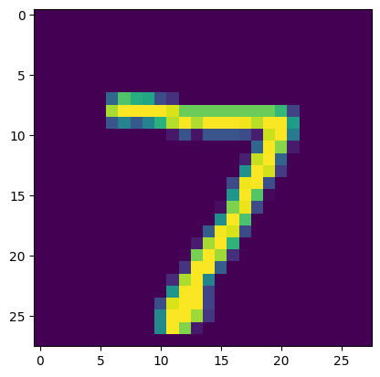
RESULT
7
Clear Text
Figure 1
‹#›

Slide 10
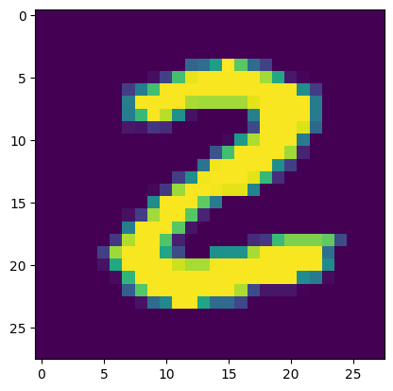
RESULT
2
Clear Text
Figure 2
‹#›

Slide 11
Conclusion
The developed handwritten digit recognition system is currently running on localhost and uses Convolutional Neural Network (CNN) architecture with PyTorch and Flask for web deployment. Users can currently run real-time performance tests on the model. In the future, the accuracy and generalization of the system could be improved by investigating methods such as transfer learning and optimizing its performance with sophisticated CNN structures. Enhancing the user interface and putting it on cloud servers may also increase scalability and accessibility. Future developments might allow for the recognition of multiple digits and the processing of entire handwritten texts, creating new application areas in the fields of finance, education, and digital document processing.
‹#›

Slide 12
REFERENCES
Tensorflow: https://www.tensorflow.org/
Numpy: https://numpy.org/
PyTorch: https://pytorch.org/
Flask: https://flask.palletsprojects.com/en/3.0.x/
Inspiration: https://projectworlds.in/artificial-intelligence-project-handwritten-digits-recognition/
‹#›

